Slide 1
Personal Portfolio Website
Created by:- Priyanshu Singh
(202501100100197)

Slide 2



Personal Portfolio Website
This presentation describe my personal portfolio website, which showcase my skills, services, and projects. It is like a digital identity, allowing visitors to explore my work, understand my capabilities, and easily connect with me.
Core Concept
Digital Identity
A clean, modern dark-theme UI built with HTML, CSS, and basic JavaScript.
A hub for visitors to learn about me, view my work, and initiate contact.
Design Philosophy
Focused on simplicity, smooth navigation, and professional presentation.

Slide 3






Key Features
Home Section
About Section
A home section which displays:- "Hi, I’m Priyanshu Singh – Web Developer from India," with my name highlighted in a vibrant red color.
A space including my profile image and a personal introduction. It includes a dynamic interface for easy access to my Skills, Experience, and Education, with smooth transitions.
Services Section
Portfolio/Work Section
A visually appealing grid layout which shows my offerings: Web Design, UI/UX Design, and App Design. Each card features an engaging hover animation that changes its colour and subtly lifts it upward.
A section which showcase my work or projects which I have done. Each project displays a layered overlay on hover, revealing its title and a brief description.
Contact Section
Smooth Animations & Effects
This section provides my contact details which are my email address and mobile number. I t also has a ‘download CV’ button. It also provides a message box where people can drop their messages.
The website includes subtle hover effects, easy navigation and smooth scrolling, enhancing the overall user interaction and visual appeal.

Slide 4

Technologies/Tools Used
Below are the technologies as well as tools from html, CSS and Javascript which has been used in my portfolio.
Frontend Technologies
Design & Development Tools
HTML5
Images
HTML5 language is used for structuring the entire website content, ensuring semantic and accessible markup.
Images have been used in my profile as well as wherever there is a need to enhance the website visually.
CSS
VS Code & DevTools
CSS is used for advanced styling, creating responsive layouts and attractive visual effects.
VS Code has been used as a code editor with development tools it provides to ease the process of generating the website.
JavaScript
It is used for interactive elements such as dynamic tab switching, smooth animations, and enhancing overall user engagement.
Google Fonts (Poppins)
Google Fonts has been used to make it look aesthetic and appealing wherever it is possible.

Slide 5

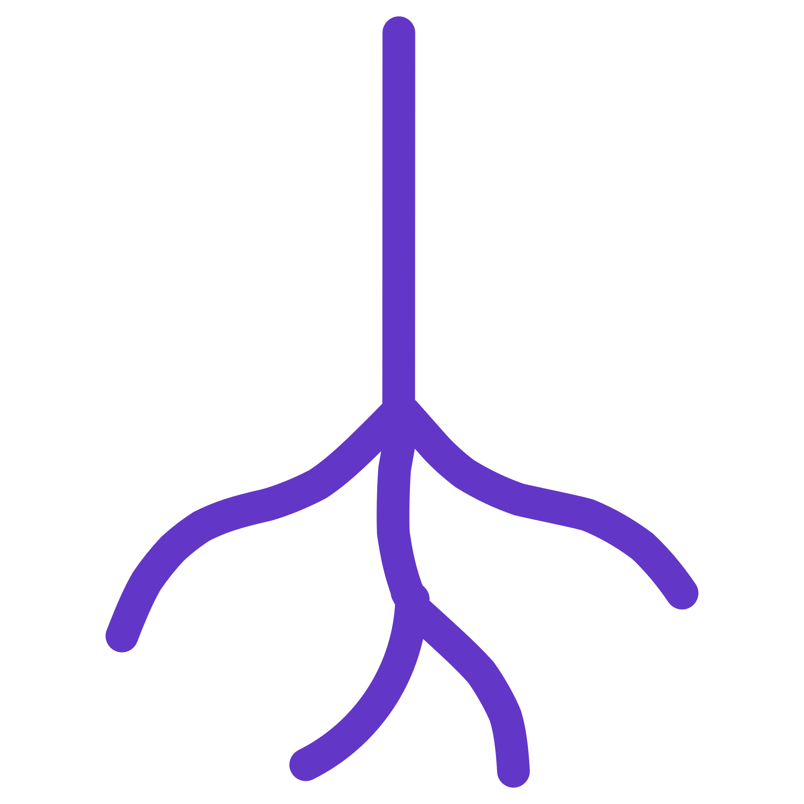


Essential HTML Tools used in designing
the portfolio.
<!DOCTYPE html>
Document Type: Declares the document as HTML5, essential for correct rendering.
<html>
Root Element: The container for all other HTML elements on the page.
<head>
Metadata Container: Holds non-visible information about the page, like its title and links to stylesheets.
<meta>
Page Info: Provides essential metadata for browsers and search engines.

Slide 6
HTML Building Blocks: Content & Interaction
<title>
<link>
Page Name: Sets the title displayed in the browser tab.
Connect: Links external resources like CSS stylesheets to your HTML document.
<body>
<div>
Content Area: Contains all visible page content, from text to images.
Generic Container: A versatile block-level element for grouping and styling content.
<nav>
<ul>
Navigation: Defines a section containing navigation links.
Unordered List: Creates a bulleted list of items.
<li>
<a>
List Item: Represents an item within an ordered or unordered list.
Hyperlink: Creates clickable links to other pages or resources.

Slide 7
Styling with CSS: Making Webpage Beautiful
* (Universal Selector)
margin
Reset Margin: Selects all elements to apply universal styles.
Spacing: Controls the outer spacing around an element.
padding
font-family
Inner Space: Controls the inner spacing between an element's content and its border.
Typography: Specifies the typeface for text.
box-sizing
scroll-behavior
Layout Model: Defines how an element's total width and height are calculated.
Smoothness: Controls the scroll animation for scrollable boxes.
background-color
color
Background Color: Sets the background colour of an element.
Text Colour: Sets the colour of the text within an element.

Slide 8
Advanced CSS Techniques: Layout & Responsiveness
01
02
width & height
background-size
Size Control: Define the dimensions of elements.
Scaling: Adjusts the size of the background image.
03
04
background-position
display
Alignment: Positions the background image within its element.
Layout Method: Specifies how an element is displayed, influencing its layout behaviour.
05
06
flex
justify-content
Flexible Alignment: A shorthand for setting the flex properties on a flexible item.
Content Positioning: Aligns items along the main axis of a flex container.
07
08
align-items
flex-wrap
Centering: Aligns items along the cross axis of a flex container.
Wrapping: Controls whether flex items are forced onto one line or can wrap onto multiple lines.
09
10
list-style
text-decoration
Bullets: Styles the bullet points or numbering of list items.
Text Decoration: Adds lines (underline, overline, line-through) to text.

Slide 9
CSS for Interactivity & Aesthetics
1
2
3
font-size
position
transition
Text Size: Sets the size of the font.
Placement: Controls an element's positioning on the page.
Animation: Creates smooth changes in CSS property
values over a duration.
4
5
6
margin-top
font-weight
padding
Top Gap: Specifies the margin space on the top of an
element.
Boldness: Sets the thickness (or boldness) of the
characters in text.
Inner Space: Controls the inner space of an element on all
sides.
7
8
9
border-radius
grid-template-columns
grid-gap
Rounded Corners: Adds rounded corners to an
element's border.
Grid Layout: Defines the column tracks of a grid layout.
Grid Spacing: Sets the size of the gap between rows and columns in a grid layout.
10
11
12
transform
background
overflow
Movement: Applies 2D or 3D transformations to an
element.
Fill: A shorthand property for setting all background
properties.
Overflow Handling: Specifies what happens to content that overflows an element's box.
13
14
15
text-align
cursor
border
Alignment: Aligns the inline content of a block element.
Pointer: Specifies the mouse cursor to display when pointing over an element.
Outline: Sets the border properties (width, style, colour)
for an element.

Slide 10
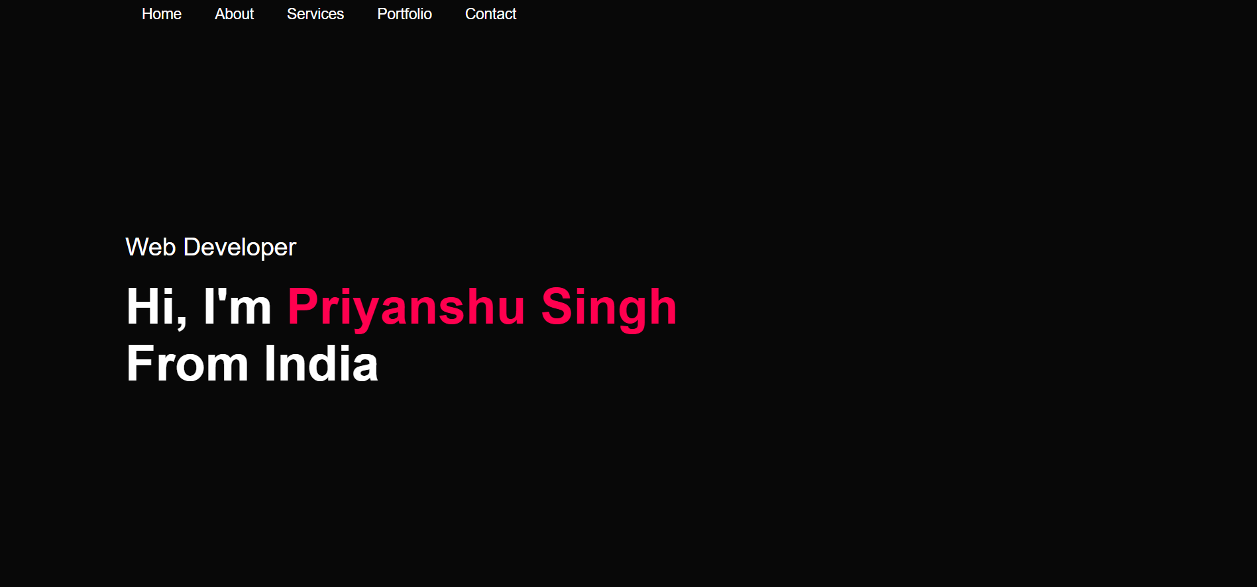
Visual Showcase: A Glimpse of the Portfolio
The contact section, featuring the dark-themed form with styled input fields, a clear submit button, alongside my contact details and an easily accessible CV download option.

Slide 11
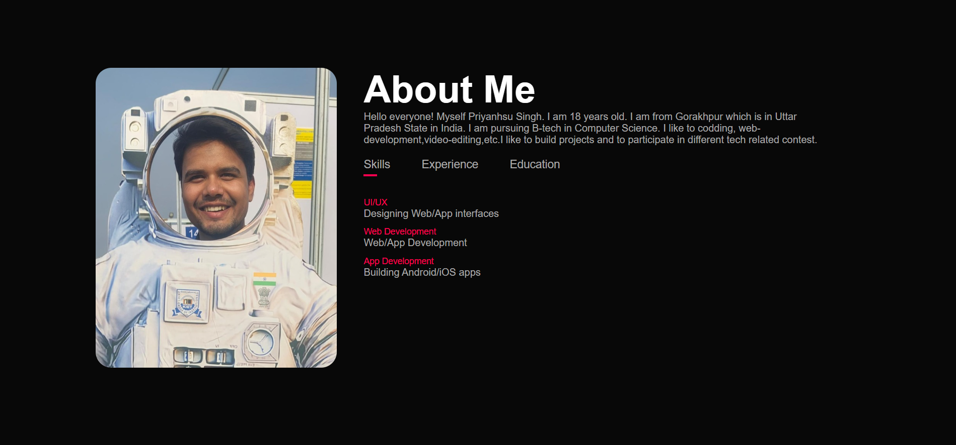
Visual Showcase: A Glimpse of the Portfolio
The contact section, featuring the dark-themed form with styled input fields, a clear submit button, alongside my contact details and an easily accessible CV download option.

Slide 12
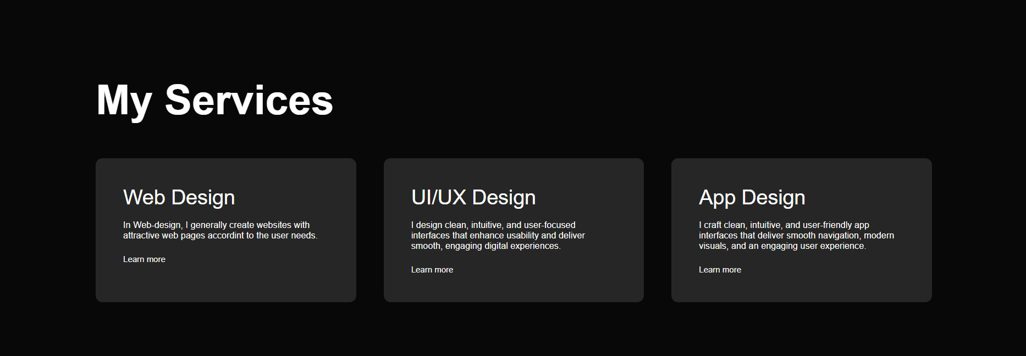
Visual Showcase: A Glimpse of the Portfolio
The contact section, featuring the dark-themed form with styled input fields, a clear submit button, alongside my contact details and an easily accessible CV download option.

Slide 13
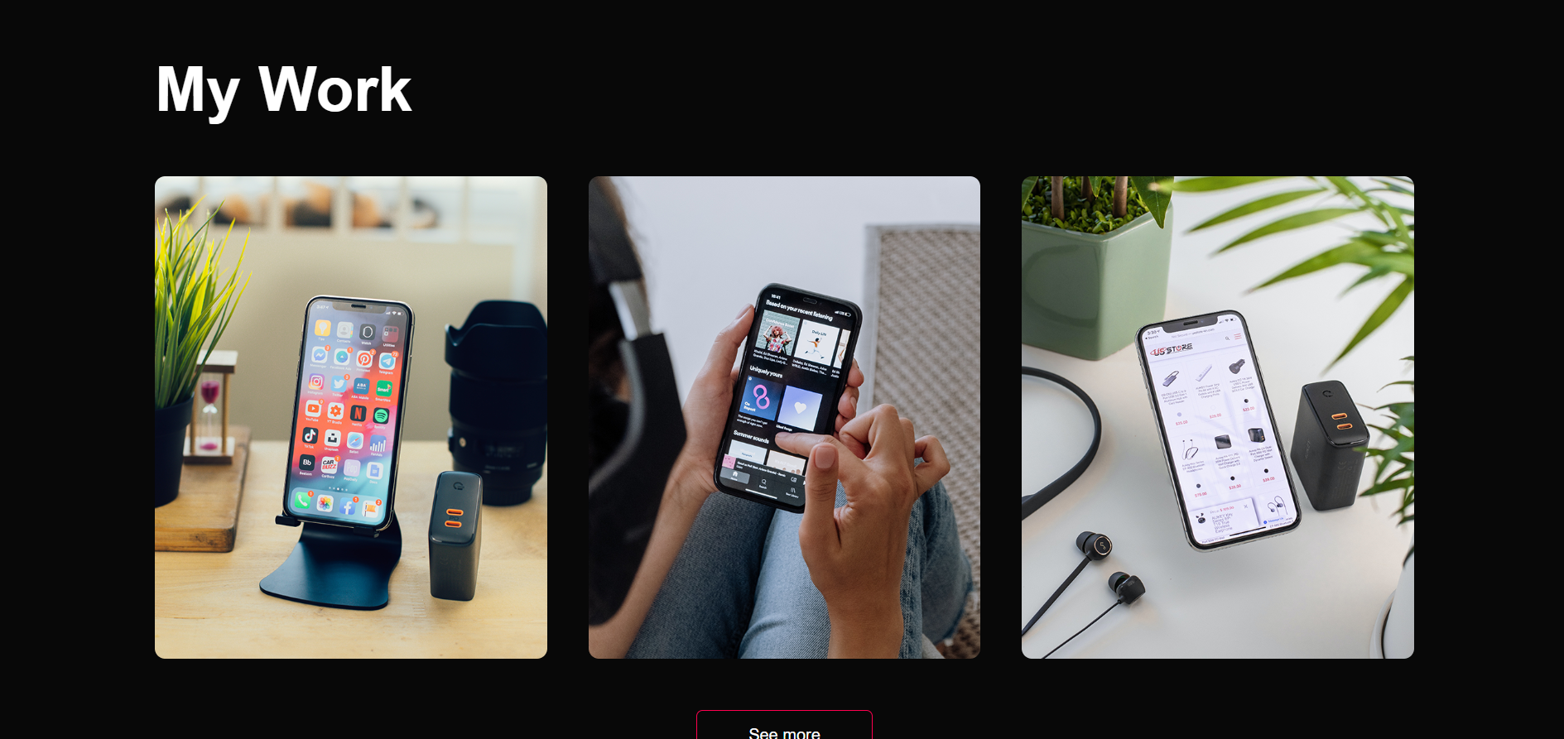
Visual Showcase: A Glimpse of the Portfolio
The contact section, featuring the dark-themed form with styled input fields, a clear submit button, alongside my contact details and an easily accessible CV download option.

Slide 14
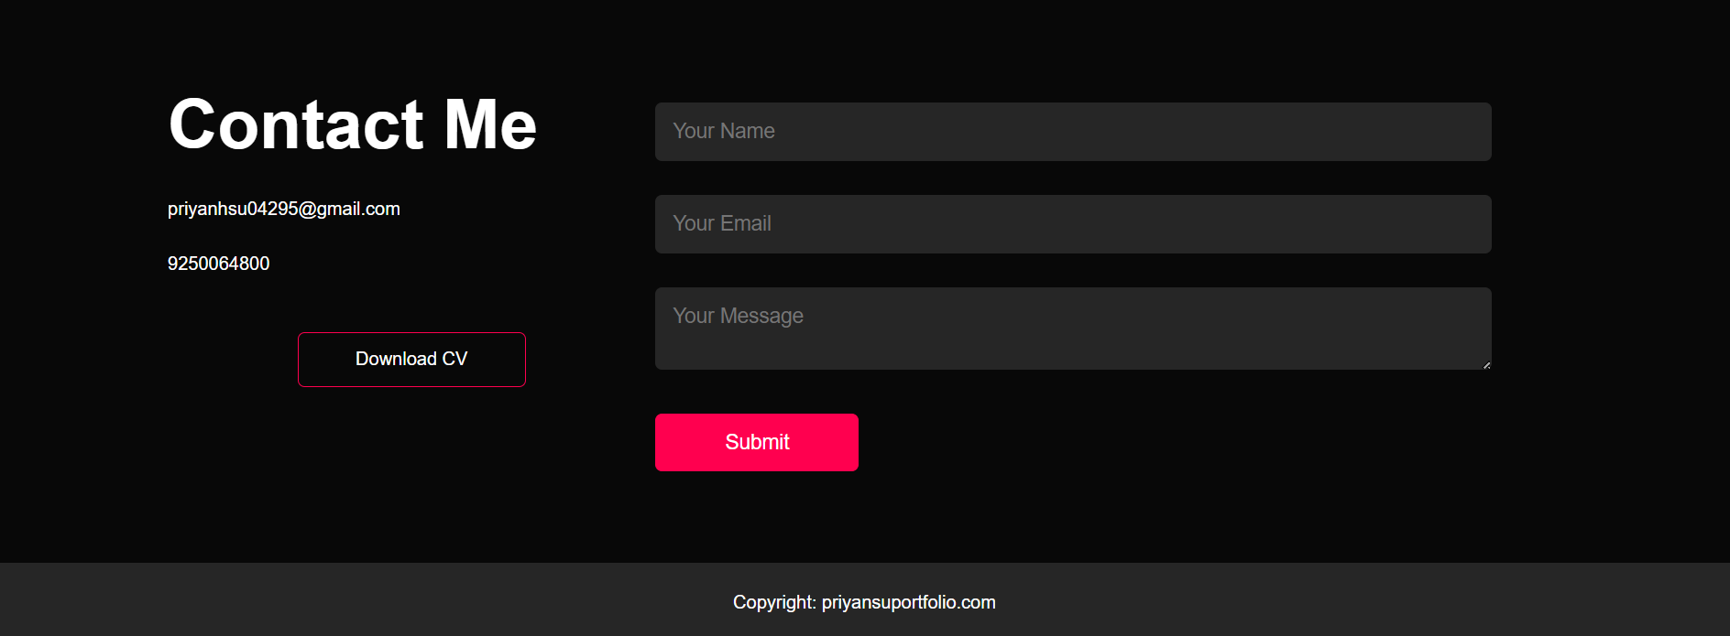
Visual Showcase: A Glimpse of the Portfolio
The contact section, featuring the dark-themed form with styled input fields, a clear submit button, alongside my contact details and an easily accessible CV download option.

Slide 15




Conclusion: A Modern, Responsive, and Professional Portfolio
Professional & Responsive
Showcasing Expertise
This portfolio embodies a professional aesthetic, crafted to be fully responsive across all devices, ensuring an optimal viewing experience for every visitor.
It stands as a testament to my web development capabilities, effectively highlighting my diverse skill set and serving as a comprehensive digital resume.
Comprehensive Overview
Built From Scratch
The website provides a clear, concise overview of my projects, services offered, and direct contact avenues, making it easy for potential collaborators to engage.
Every element of this portfolio has been meticulously built from the ground up using pure HTML, CSS, and JavaScript, demonstrating a strong command of core web technologies.

Slide 16
Thank You
The contact section, featuring the dark-themed form with styled input fields, a clear submit button, alongside my contact details and an easily accessible CV download option.

